Slide 1

Crowdfunded Tabletop Through the Years
Presented By: Geraden Hraba
Notes:
Hello my name is geraden hraba and today I will be presenting my project Crowdfunded Tabletop

Slide 2

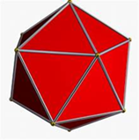
About me
My hobby is tabletop roleplaying games
Played since 2004
Boundless creativity and team building hobby
Notes:
My name is geraden hraba I first got into tabletop roleplaying game in high school. This hobby is great as it gives a chance to be creative and build relationships in the real world and in our imaginations. Ttrpg’s offer vast expanse to be creative, grieve, be joyous, and vent our frustrations and to be away from our own personal problems a few hours a week. It helps with coordinating teamwork, optimization, gives us a responsibility. And many other facets. I have built long standing friendships and connections through this hobby.

Slide 3
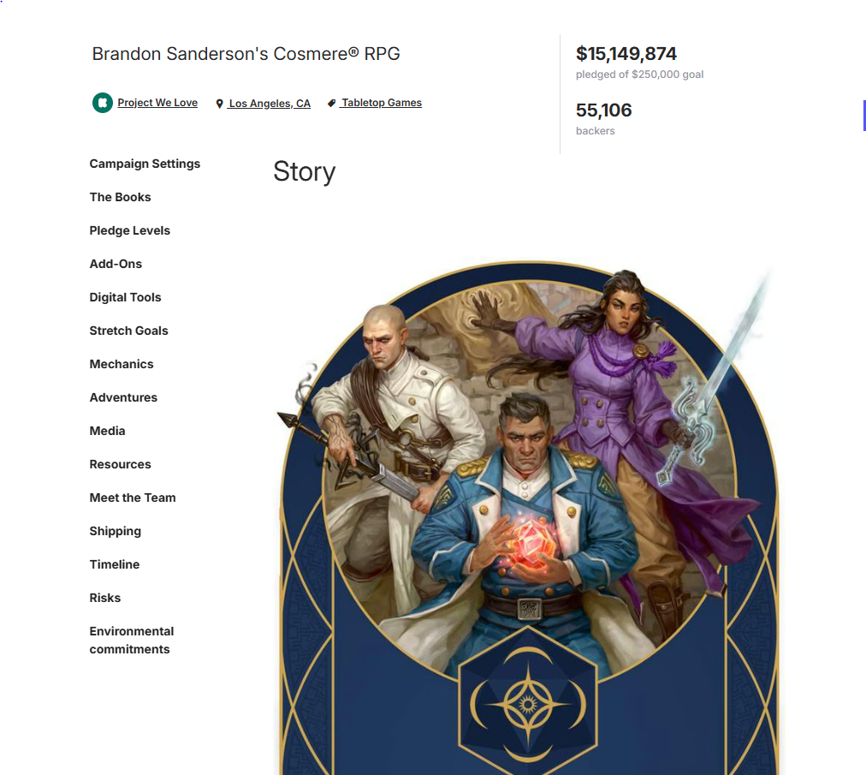
Introduction
Look at current trends of Crowdfunded TTRPG’s
Look at what games get their projects fully funded
Notes:
Today I looked at three different websites that do crowdfunding. I wished to see what type of ttrpg’s or tabletop roleplaying games on them were most successful. While looking at how many games a year were funded to see which website would be best for a company to go to fund a ttrpg in the future. I do this by looking at how many games each platform has coming into their website and how much money per game designation each earned per year. Crowdfunding is a website where people can go to ask their hopeful projected audience to help fund their project. They have set amount of fund they will require to launch it and they add benefits at certain milestones post the initial funding goal in order to incentivize additional funds and add things to the project. It is a way for a company to publish without using a publisher.

Slide 4

Terms
RPG, 5E, non-5E
Wizards
Open Gaming License
Data Points
Notes:
RPG stands for generic Role-Playing Game, where 5e is just projects for dnd fifth edition, non 5e are projects for dnd that are not fifth edition. Wizards and WOTC is short for Wizards of the coast, Open Gaming License or the OGL for short. Data points refer to a unique Crowdfunded projects. RPG, 5e and non-5e relate to one another by being all apart of the same hobby of tabletop role playing games. A slight distinction for 5e and non-5e is that 5e is the flagship game and non-5e games are based on the system of dnd fifth edition but in a separate universe than 5e. Wizards is the company that owns dungeons and dragons and thus created the original OGL.

Slide 5
Lost of Trust in Wizards of the Coast
The OGL started in 2004
Changes were suggested to be changed late 2023
New OGL proposed would make the original void
New proposed licensed would require
Revenue exceeding $50,000/yr to be reported to WOTC
Revenue exceeding $750,000/yr to pay royalties
Sweeping layoffs right before Christmas
Notes:
The Open Gaming License or ogl was a free scource liscense that granted a "perpetual, worldwide, non-exclusive license" to third party developers to take the game of dnd and let third parties use the license to produce extra content for dnd. The open gaming license was suggested to be changed late of 2023.

Slide 6
Kickstarter
Data comes from 2013 – 2025
Pulled from kicktraq
Over 12000 entries in these years
2024 has the highest number of games for two RPG types
Notes:
We will start by looking at kickstarter data today. The data I was able to gather range from 2013 to 2025 with just .6% of projects I found still ongoing at the time. There were over 12000 different entries into the dataset with the three categories of games being 5e, non-5e dnd. 2024 had 802 5e crowdfunded projects, 589 projects for non-5e dnd, while in 2023 had 522 games n RPG

Slide 7
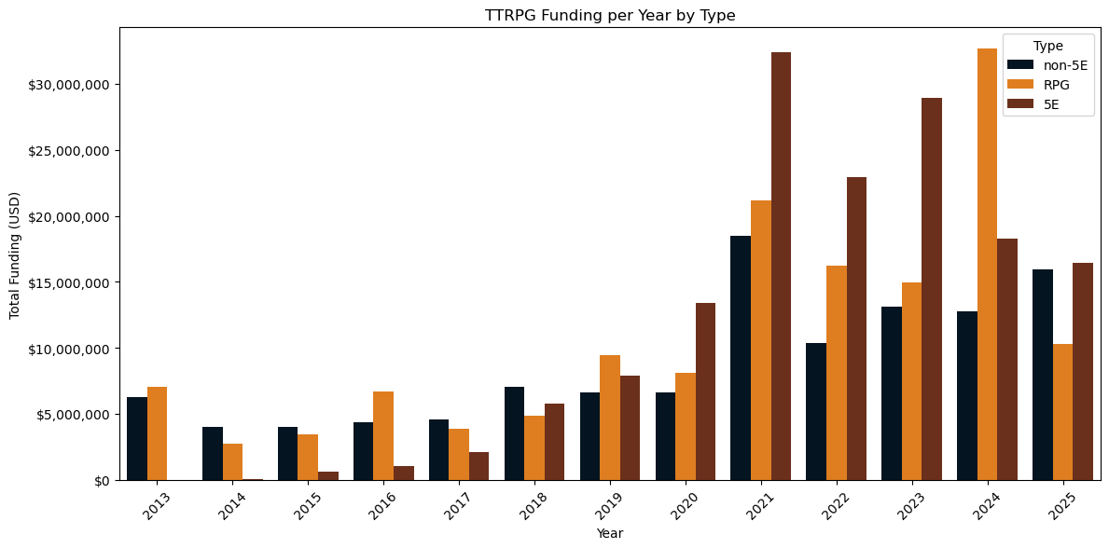

Funding over the Years
In 2021 crowdfunding surged due to a SEC rule change
In 2024 5E dropped off from the top projects. Likely due to WOTC losing the trust of their fans the preceding DEC.
Cosmere RPG earned $15 million alone in 2024
Notes:
On this side we are looking at how much money each type of kickstarted project earned by year. 2014 was the year that dnd 5th edition released and we can easily see its rise in popularity for crowdfunding. This is likely do to the open gaming lisence that DND has had in place since 2004 with dnd 3rd edition. In 2021 there was a sec rule change that allowed for companies to ask for more money for crowd funding projects. We see in 2024 a large dip in 5e crowdfunded funds this is likely due to the OGL scandal and the fact that dnd 2024 was released. With a new edition released and very recent bad press for the company would probably go to explain the massive decline in crowd funding as people looked for other games to play. The spike in 2024 for RPG could most likely be attributed to the Cosmere rpg game that was fully funded that year raising by itself just over $15 million

Slide 8
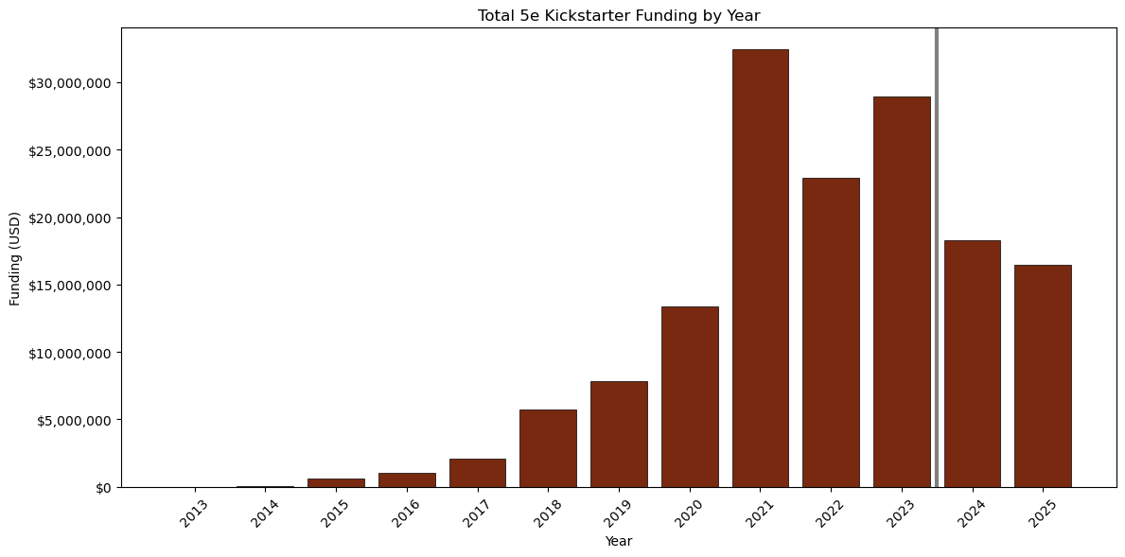
Fifth edition over the years
From 2023 to 2024 there is the largest drop in raised funds for any project.
From 2024 to 2025 instead of bouncing back like they had in 2022 they continued to decline
Notes:
Here I want to show you just the progression of 5e with a dividing line of when the ogl scandal took place.

Slide 9
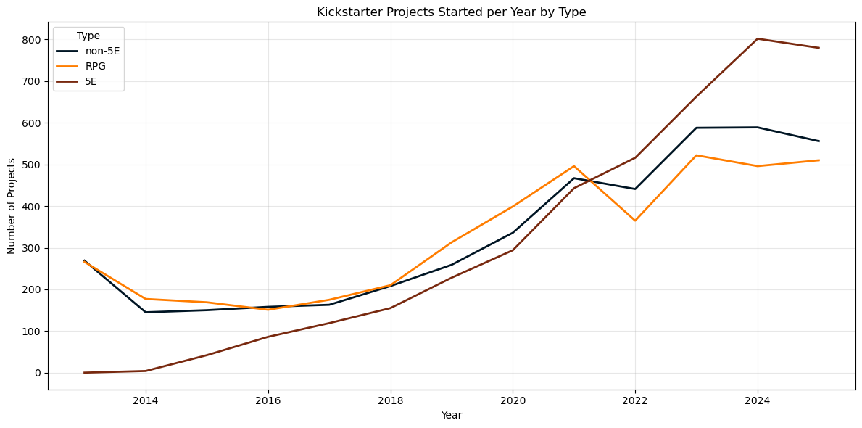
Projects over time
While projects still rose steadily until 2023 where number of projects dipped slightly
Non-5E and RPG’s have plateaued post 2023
Notes:
On this slide we are looking at the number of projects each system had on Kickstarter throughout the years. 5e rose steadily every year since it first released in 2014 only taking a slight dip in 2024 into 2025. where other dnd projects and other rpg’s stayed constant and mostly plateauing from 2023 to 2025.

Slide 10
Gamefound
Data comes from 2021-2025
Pulled from Gamefound
2025 was best successful year for funded games
New company
Notes:
For this section we are looking at the site Game found. I was able to Pull 103 different data points from the site. Between the years of 2021 and 2025.

Slide 11
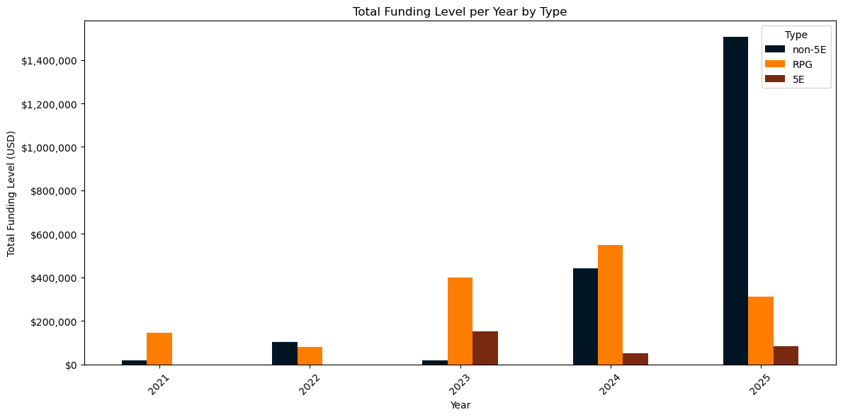
Funding over the years
Non-5E got a huge rise in 2025 raising over $1.4 million altogether
RPG’s and non-5E products seem to do better on this platform
Low over all funds being raised
Notes:
On this slide I wanted to see the amount of crowdfunds they were able to procure per category. Interesting enough dnd 5e tends to be on the lower end of the spectrum for every year that I have data for. With a large spike in non-5e products in 2025.

Slide 12
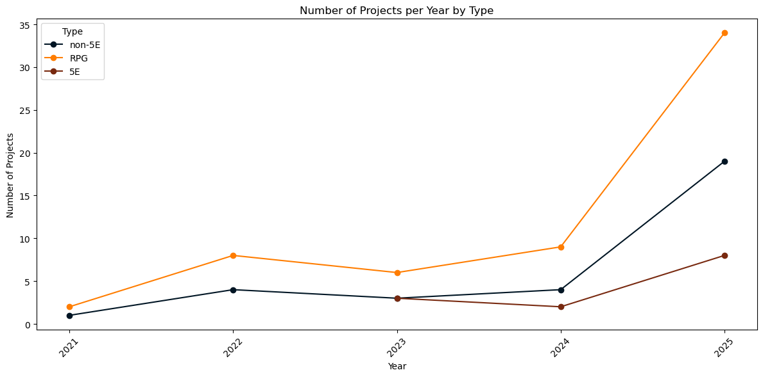
Projects over time
RPG’s consistently have the most amount of games
5E first showed on the platform in 2023
Until 2025 no system had over 10 projects being funded here
Notes:
5e first appears in 2023 for projects being backed on the site. With other RPG’s having by and large the most projects being funded on the site. We can see that until 2025 no project had more then 10 items being funded at a time.

Slide 13
Backerkit
Data comes from 2021-2025
Pulled from Backerkit
2024 had the highest project counts for all game types
Creator friendly Toolkit
Notes:
Backerkit’s creators were the first crowdfunding creators to hit six figures on kickstarter. They realized that they didn’t have a pledge manager to help them with their project so they decided to make their own and share it with other creators. They were founded in 2012. Backerkit has the second most project of the websites I looked at with just under 600 differing projects.

Slide 14
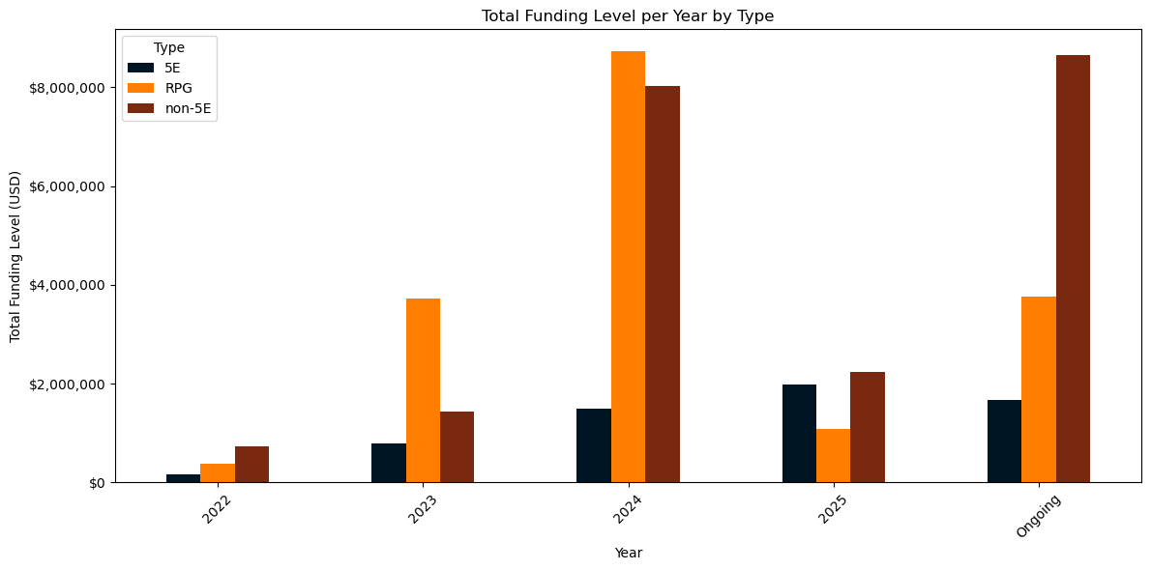
Funding by Year
Had a peak year in all systems except for 5E games in 2024
RPG’s seem to be more popular on this site.
Many ongoing games point to a healthy website.
Notes:
Backerkit saw a large decline in crowdfunding between 2024 and 2025 with a large bounce back in currently ongoing games being funded.

Slide 15
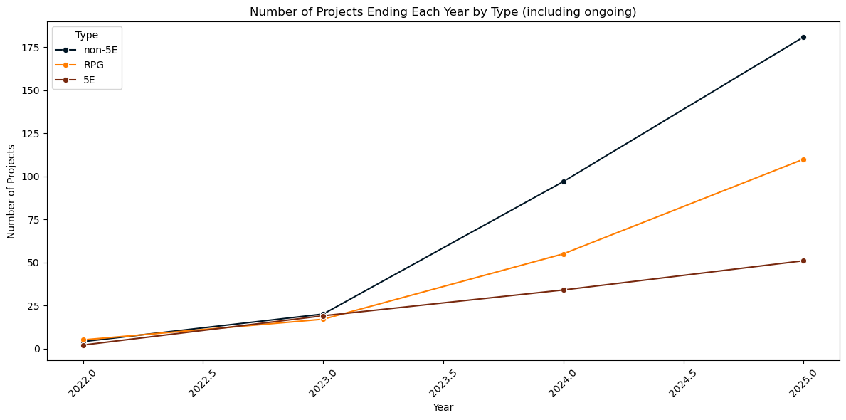
Projects over time
Each category has the most completed games in 2024
Non-5E rose at a faster rate then RPG’s or 5e
Notes:
From 2023 moving towards 2025 there has been a steady increase in all three category of games being funded

Slide 16
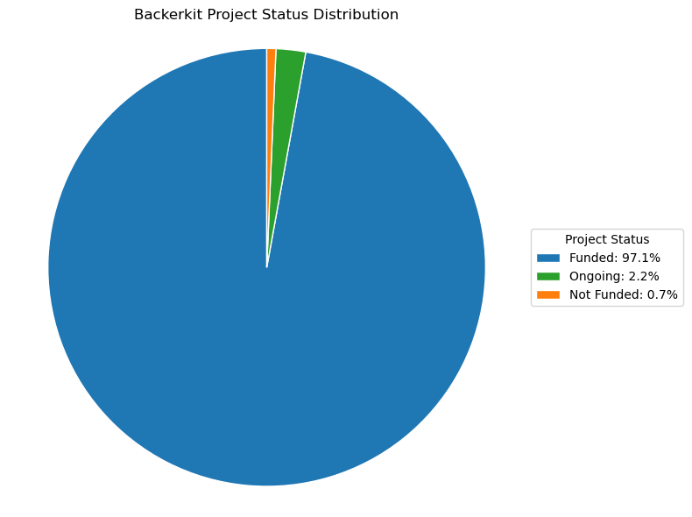
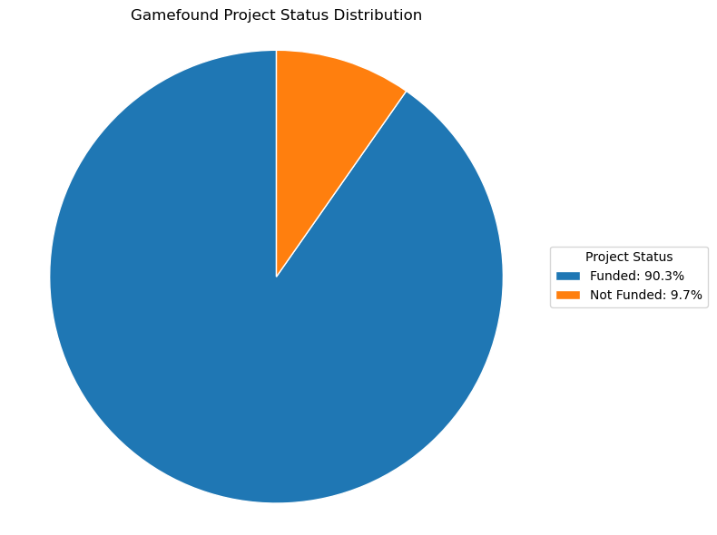
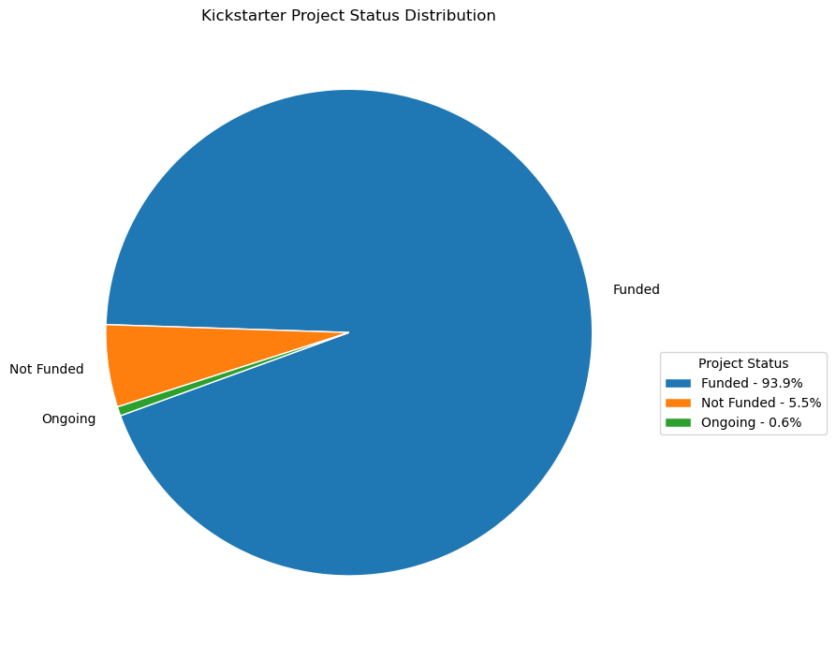
Funding Rate
Backerkit has the most percentage of their crowdfunded projects succeeding
Gamefound has the least number of games funded
Kickstarter is in the middle ground
Notes:
We can see here from the slides that backer kit has the highest percent of their games reaching a successful state at just over 97% with game found being the lowest at 90.3% with 1.9% being cancelled early and the rest reaching the end but not fully funded. Kickstarter while having the most products still have nearly 94% of their projects being funded

Slide 17
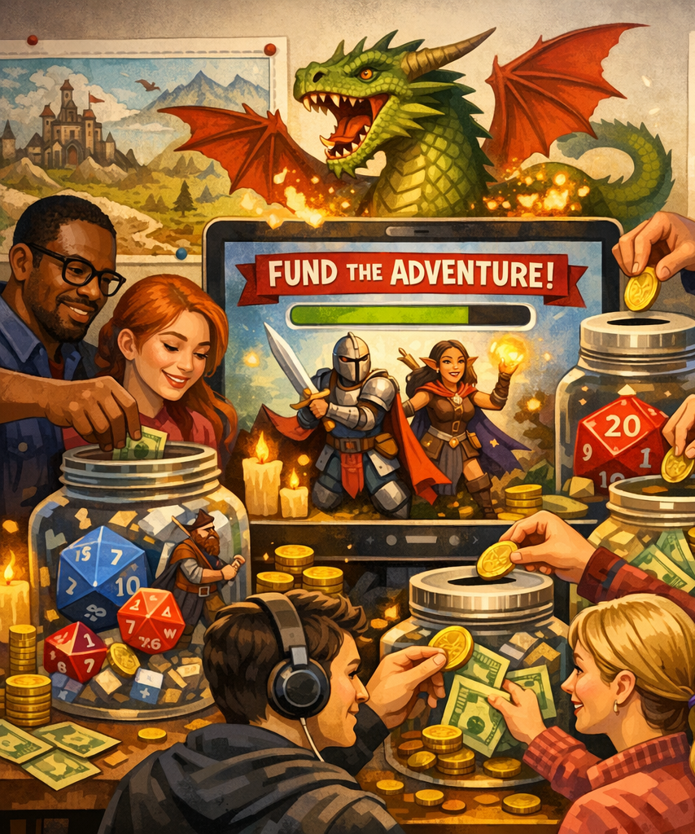
Conclusions
Backerkit is the best place to fund non-dnd products.
Kickstarter has a high success rate and dnd type projects excel here.
Gamefound is too new to make an apt comparison.
Notes:
If you wish to crowdfund a TTRPG that is a typical RPG Backerkit would give you the highest chance of success in getting funded. If you wish to crowdfund for DND 5e or non-5e games then Kickstarter is where you should go to. Gamefound is too new without enough projects being funded on it to make a fair comparison to the other two.

Slide 18
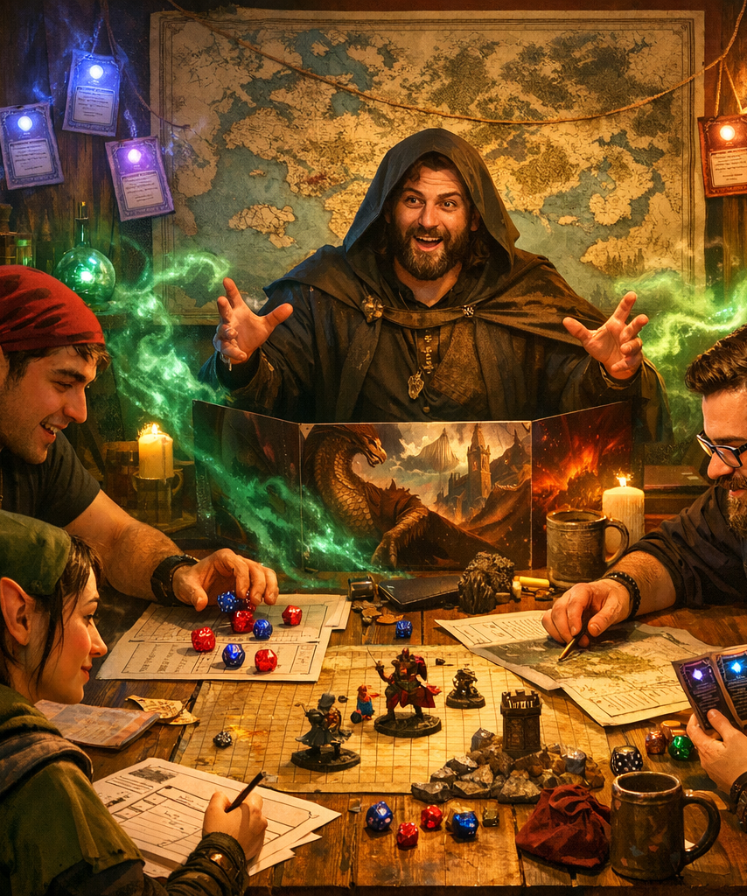
Thank you for your time
For further analysis I would like to wait a few years for gamefound to start pulling in more data
I would like to also see how long each project lasted and if that effected its success rate.
I would like to see which game for each RPG type got the most crowdfunding
This data only include games I would also like to investigate game accessories in the future as well

Slide 19

Geraden Hraba
https://www.linkedin.com/in/geraden-hraba/
Geraden.hraba@gmail.com
https://github.com/geradenhraba-cell

